Slide 1
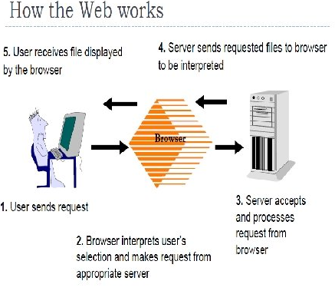

Slide 2
How does the web work?
A user enters a URL into a browser (for example, Google. com.
This request is passed to a domain name server.
The domain name server returns an IP address for the server that hosts the Website (for example, 68. 178. 157. 132).
The browser requests the page from the Web server using the IP address specified by the domain name server.
The Web server returns the page to the IP address specified by the browser requesting the page.
The page may also contain links to other files on the same server, such as images, which the browser will also request.
The browser collects all the information and displays to your computer in the form of Web page.

Slide 3
What do you need to be a web developer ?
What qualifications do you need to become a web developer ?
User experience (UX)
User interface (UI)
Visual design
Coding languages including HTML and CSS
Frontend web programing languages and skills such as JavaScript, Ajax and web animation techniques
Backend web programing languages such as C# or Java, PHP and Ruby
Design software like Photoshop and Illustrator and Sketch
An understanding of SEO
Web servers and how they function

Slide 4
WHAT KNOWLEDGE SHOULD A WEB DEVELOPER HAVE ?
HTML/CSS skills: If you hope to become a web developer, it’s important that you understand HTML and CSS.
Analytical skills: As a web developer, you will need to have analytical skills to create a multifariousness of websites.
Responsive design skills: If you work as a web developer, it’s important to understand how responsive works.
JavaScript skills: JavaScript is a high-level programming language that implements features onto a website.
Interpersonal skills: This includes various social skills like good body language, active listening skills, and overall good work and positive attitude.
Testing skills: As a web developer, it is important to know how to continuously test your webpage for any possible errors.
Back-end basics: You will also need to understand the fundamentals of back-end web development.
Search engine optimization: As a web developer, it is important that you know all about search engine optimization.
Browser developer tools: Users will finally be interfacing with your websites through a web browser.

Slide 5
What is the role of a web developer.
Write well designed, testable, efficient code by using best software development practices.
Create website layout/user interface by using standard HTML/CSS practices
Integrate data from various back-end services and databases
Gather and refine specifications and requirements based on technical needs
Create and maintain software documentation
Be responsible for maintaining, expanding, and scaling our site
Stay plugged into emerging technologies/industry trends and apply them into operations and activities
Cooperate with web designers to match visual design intent

